Slide 1

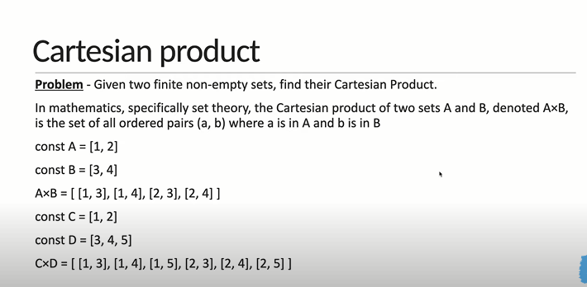
Cartesian Product

Slide 2
